Slide 1

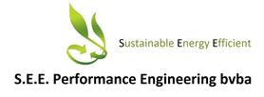
Availability and accessibility of biomass residues in the tropics
The alternative / complement to electric

Slide 2
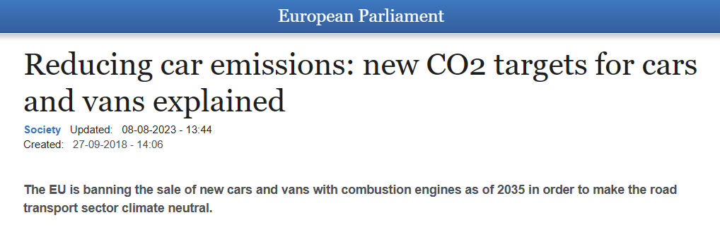
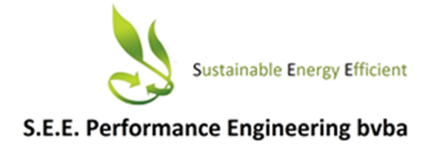
Why “ALL – IN “ with electric / hydrogen?
Why not supporting development of climate neutral
biofuels (RED II compliant) ?

Slide 3

Abundance of biomass residues
With a population of over 8 billion, food production in agriculture is massive!
Based on FAO data, world’s agricultural food production is 11,3 trillion metric tons /year,
Cultivated area is estimated at 1.65 trillion ha (size equivalent to 1.5 x Europe).
Food production also generates +- 15 trillion metric tons/year of agricultural residues,
which mostly reside on the plantations and decompose into CO2 and CH4,
serving the only purpose of returning nutrients(N, P, S, K, etc) to the plants.

Slide 4
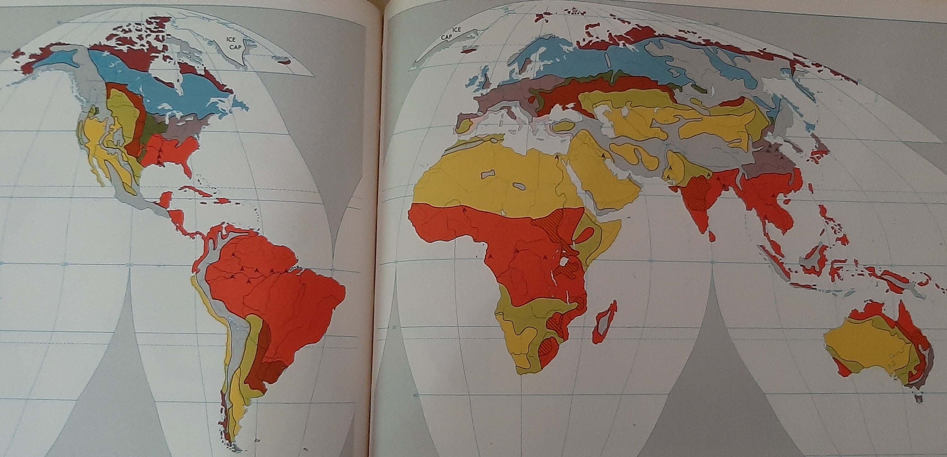
Importance of bio-residues for agriculture
Soils over the world
Red: Latosol soil, deeply weathered and infertile

Slide 5
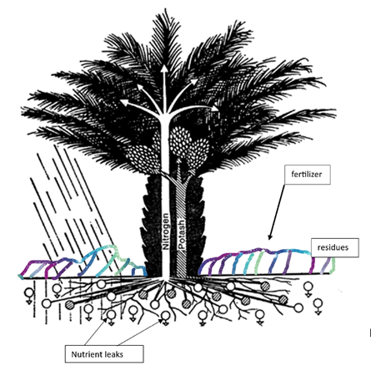
Contrary to soils in other parts of the world e.g. Ukraine, tropical soils are generally infertile.
If any natural vegetation exists, this consist of rich but complicated ecosystems growing above
(up to 100 m) ground, where nutrients are stored in living organisms and decomposing biomass.
Deforested tropical soils are therefore not suited for agriculture, except of small areas with
alluvial, vulcanic or biochar deposits. With heavy rain and porous soils, nutrients cannot be kept
available for absorbtion by plants so huge amounts of residues and “slow release” fertilizer are needed.

Slide 6
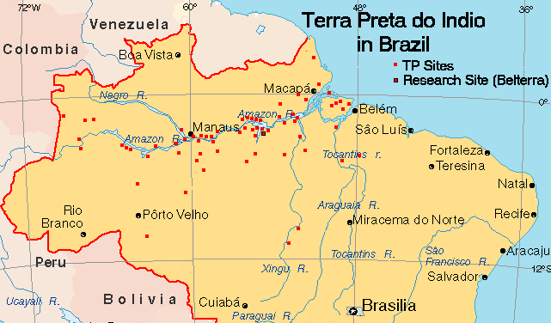
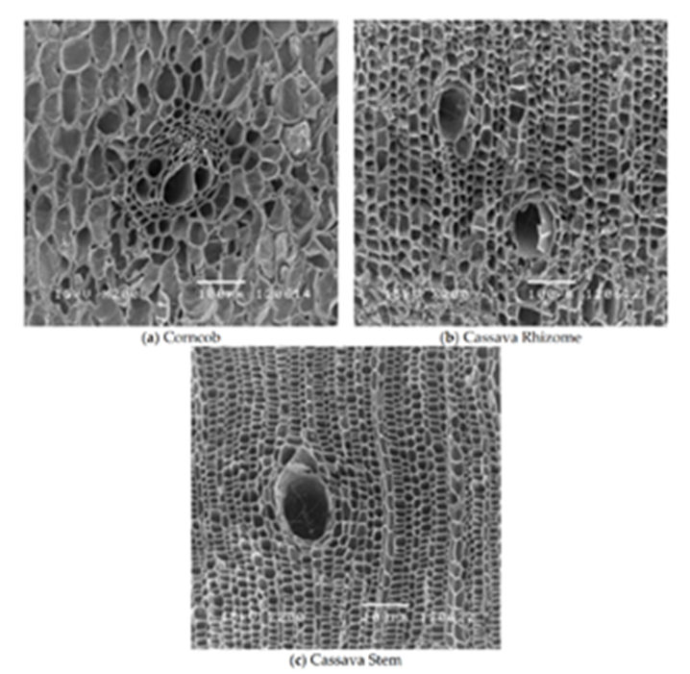
What if the soil would be enriched with biochar?
Biochar or “Terra Preta” in Amazon basin:
Along the Amazon in South America, small very fertile areas
have been discovered where, probably due to human activity,
soils have been enriched with charcoal.
The biochar deposits are beleived to originate from indigenous
soilmanagement and slash-and-char agriculture over several
thousands of years. It is estimated that the Terra Preta makes
up to 3% of the Amazon basin.
Charcoal or biochar has, due to its stable and fine microstructure,
the capacity to bind and hold nutrients.
If applied to tropical topsoils it will retain nutrients and prevent
them from leaking out, thus reducing the need to keep the residues
on the plantation.

Slide 7
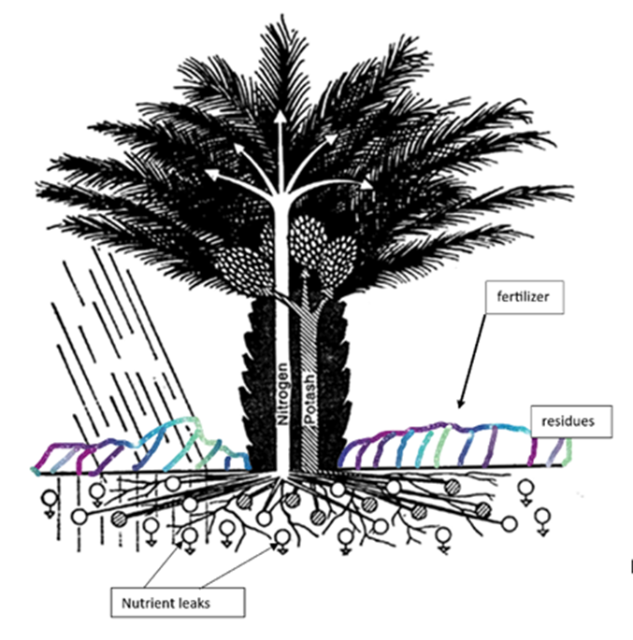
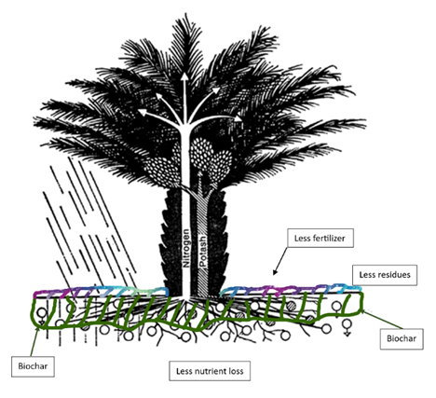
Without biochar
With biochar
Biochar reduces the demand for residues and fertilizer on the plantation!
Thus increasing availability of residues for power generation and
production of chemicals(biofuels).

Slide 8
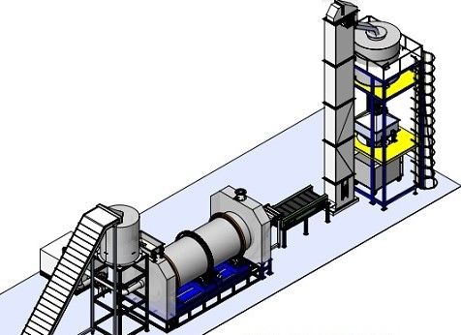
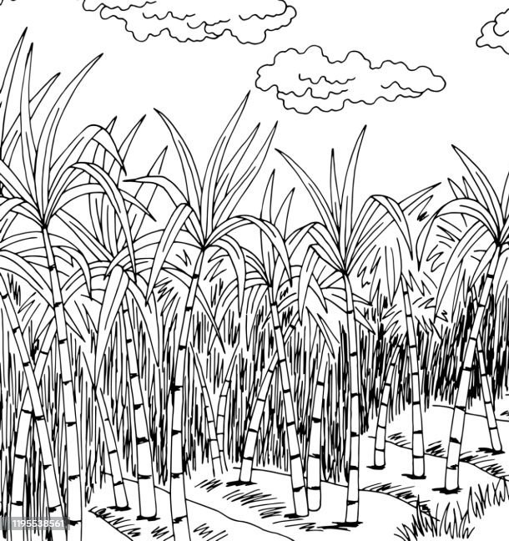
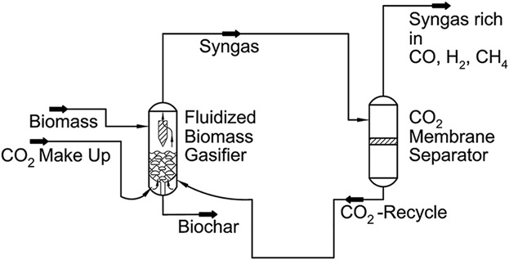
Where to get the biochar? At what cost?
If residues are not required on the plantation as fertilizer, the biomass becomes an excellent fuel,
even better when processed to biocoal and gasified to syngas (H2 + CO).
Syngas is a typical feedstock for chemical industry, where it can easily be converted to methanol or
many other biofuels.
Interesting is that biochar is a byproduct(20 %) of gasification and if processed nearby
the plantation, it can be returned at a very low cost together with the nutrients imbedded in the ashes.
Biocoal
residu
Biochar & nutrients

Slide 9
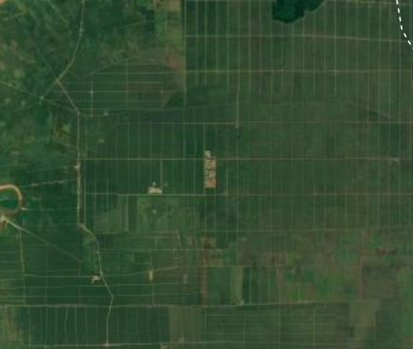
Accessability of biomass residues
Assuming that tropical soils are improved by addition of biochar and residues can be taken away from the field, still logistic issues will remain as very wet and bulky biomass must be transported to a biofuel refinery or gasification power plant.
As yield of agriculture products is relatively low, vast area of land are cultivated to produce the required quantity of crop and residues.
E.g., a palm oil mill will process production from a plantation with area between 3,000 and 10,000 ha (5,000 ha = 50 x 50 km).
Internal transport, partly manual, partly by small trucks is slow and difficult.

Slide 10
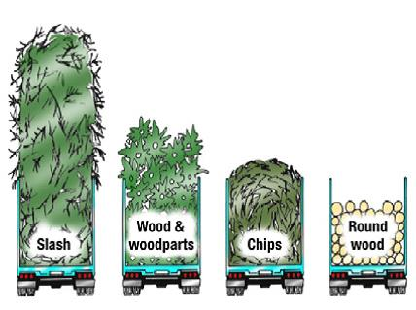
Accessability of biomass residues
For external transport, crops and residues must be transferred to bigger trucks.
The distance to the nearest port/industrial area is often up to 250 km, a distance that will take up to 6 hours for a truck in very dense and dangerous traffic.
Energy density of average non-treated residue is 25 times lower than that of e.g., fossil coal, due to high moisture and light product.
Additionally, the biomass will loose very quickly its energy value as, due to the hot and wet weather it decomposes during transport and storage.
Untreated biomass residues in the tropics are, because of cost, not accessible, but if processed in the mills and converted to ‘biocoal‘, transport cost is because of its high energy density and hydrophobicity, not an issue anymore.

Slide 11
Accessability of biomass residues
The biocoal is an ideal clean feedstock for syngas gasification or gasification power generation, as the dirty components (tars, chlorines, ...) and water have been extracted already during torrefaction.
Biocoal can be transported over long distances and be shipped and exported.
However, as biochar and ashes are to be returned to the plantation, syngas
gasification and biofuel(methanol) plants should be in a port or industrial area,
not far(+- 200 km) and central to the plantations from which the feedstock is supplied.
From there, e.g. “Green Methanol“ can be exported worldwide.

Slide 12
Are biomass residues available and accessible?
Although under above scenario bio residues in the tropics can be available and accessible, it will depend on the agricultural industry who owns the biomass.
Therefore, it is this industry that will decide if and under what conditions biofuel production from residues can be developed, and if it wants to make the switch to market these feedstocks or not.
Enabling production of RED II compliant biofuels, will have an enormous positive GHG mitigation effect, knowing that at this moment agriculture (individual farmers, cooperatives, small and big agricultural industry) is a major user of fossil fuel (fertilizer, transport, processing), often emitting high amounts of methane on their plantations and responsible for vast deforestation.

Slide 13
Conclusions
• Agricultural residues are available if tropical soils are enriched with biochar.
• Extraction of residues from plantations must be in balance with the amount of biochar returned.
Biochar must be an integral part of the “residue to biofuel” production chain.
Logistic cost must be minimized by integration of biocoal production and
gasification should be nearby minimizing transport cost of biocoal and biochar/ashes.
• Agri- industry is the key player.

Slide 14
Thank You
PPT slide as well as the extended paper are available under the Conference link
on our website,
www.seeperformance.be
Filip Vandeputte
info@seeperformance.be
+32 485 94 70 19

